Slide 1


Slide 2

20 Thousand Students Annually
43% Girls and Young Women
46% African-American or Latino

Slide 3
Goals for this Workshop
Explore the challenge of algebra
Get comfortable with programming
Work through the entire curriculum
Discuss pedagogy
At the end: discuss integration

Slide 4
Agenda
Theory
Overview
Practice
Pedagogy

Slide 5



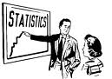
Algebra Matters
Notes:
Equity implications of these points

Slide 6

A train leaves Chicago at 6pm, traveling East at 70mph…
Notes:
Unfortunately, algebra scares the hell out of most americans!

Slide 7
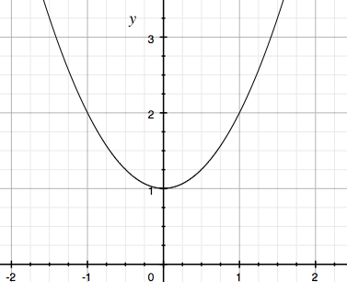
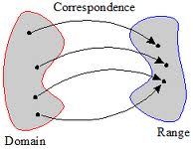
Why is Algebra so Hard?
☐ = 4+2
f(x) = x+2
6 = x+2
6 = ☐+2
process
object
x | f(x)
-1 | 2
0 | 1
-1 | 2
f(x) = x² + 1
Notes:
Emmanuel does this

Slide 8
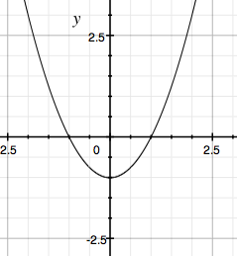
“How many roots does f have?”
x | f(x)
-5 | 24
-3 | 8
-2 | 3
f(x) = x² - 1

Slide 9
Make representations concrete and connected

Slide 10


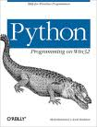

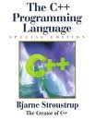
Programming has functions!

Slide 11
Programming != Math
But there’s a problem...
1 / 2 = ??
x = 10
x = x+2
foo = 0
function f(x){
return foo++
}
Notes:
Dubinsky 1992, 1995

Slide 12
Agenda
Theory
Overview
Practice
Pedagogy

Slide 13
Who is Bootstrap for?
Grades 6-7: First Exposure to Algebra
Grades 8-10: Algebra Enrichment
Grades 11-12: Algebra Remediation

Slide 14
Bootstrap Materials
Software: In the cloud, or on your machine.
Lesson Plans: Detailed[*] curricula, student handouts, integrated workbooks, and supplemental activities.
Standards: All lessons are aligned to National and State Standards for Mathematics.
Language: Algebraic semantics, simple syntax, rich media and integrated testing

Slide 15
10,000 Foot View
Brainstorming, and Circles of Evaluation
Datatypes, Domain &Range
/
9
= f(9, g(2, 3))
*
2
3

Slide 16
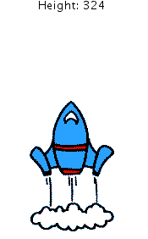
10,000 Foot View
Brainstorming, and Circles of Evaluation
Datatypes, Domain &Range
Defining Functions
Animating your Game
height : Number -> Number
height(1) | 7 * 1
height(2) | 7 * 2
height(3) | 7 * 3
height(t) = 7 * t
Notes:
How do we know the kids are actually getting this?
We do something that most colleges don’t do: code reviews.

Slide 17
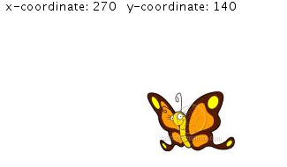
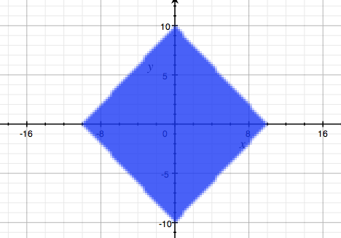
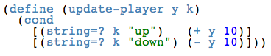
10,000 Foot View
Brainstorming, and Circles of Evaluation
Datatypes, Domain &Range
Defining Functions
Animating your Game
Booleans and Inequalities
Piecewise Functions
0 < f(x) < 640
Notes:
How do we know the kids are actually getting this?
We do something that most colleges don’t do: code reviews.

Slide 18
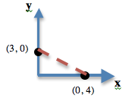
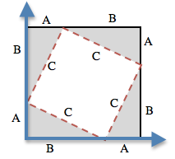
10,000 Foot View
Brainstorming, and Circles of Evaluation
Datatypes, Domain &Range
Defining Functions
Animating your Game
Booleans and Inequalities
Piecewise Functions
Pythagorean Theorem
Game Release Party!
Notes:
How do we know the kids are actually getting this?
We do something that most colleges don’t do: code reviews.

Slide 19
Agenda
Introduction
Theory
Practice
Pedagogy

Slide 20
Setting up your classroom
Physical Materials (workbooks, pens, etc)
One computer for each pair of students
Gmail Account (per-class? per-pair?)
Log into www.WeScheme.org (IE9+, FF, Chrome)
Go to www.BootstrapWorld.org/materials

Slide 21
Unit 1

Slide 22
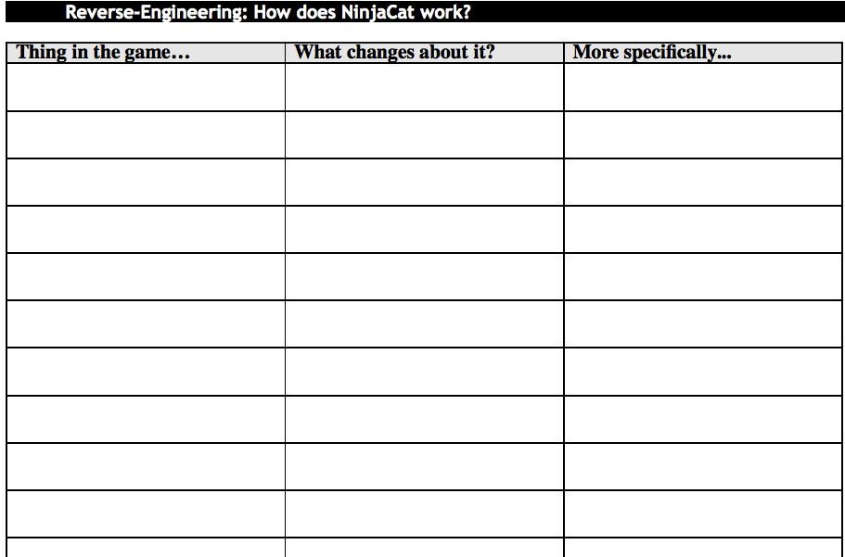
NinjaCat
Dog x-coordinate
moves to the left
position

Slide 23
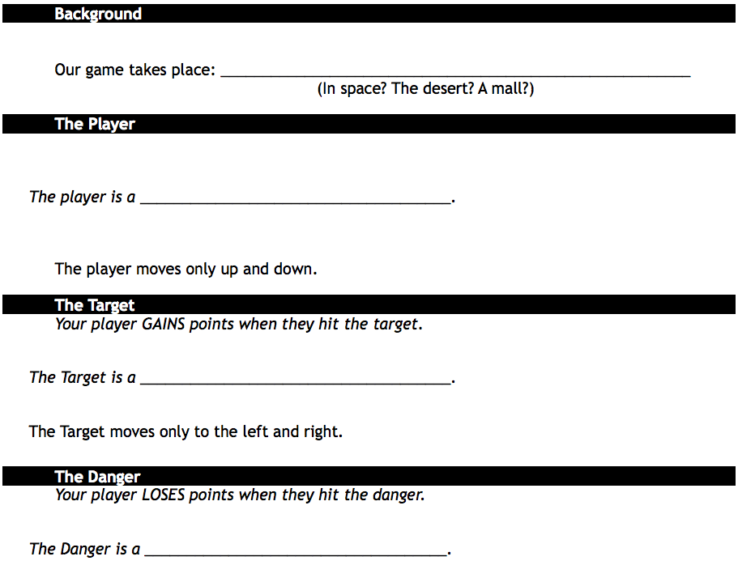
Game Brainstorming
In Space
Astronaut Squirrel
Candy
Alien Shark!

Slide 24
Starting to Program…
In www.WeScheme.org…
Start a New Program
About the Editor…
Let there be Numbers!

Slide 25
Driver / Navigator
Pair programming needs structure!
The “Driver” has their eyes on the computer
The “Navigator” has their eyes on the workbook
Switch roles regularly

Slide 26
Circles of Evaluation
-
-
10
(- )
8
(- 10 )
10
10
8
8
-
(- 10 8)
6 ÷ (10 – 8)
6 ÷ 2
/
(/ 6 )
(/ 6 ( ) )
6
2
(/ 6 (- 10 8) )

Slide 27
Unit 2

Slide 28
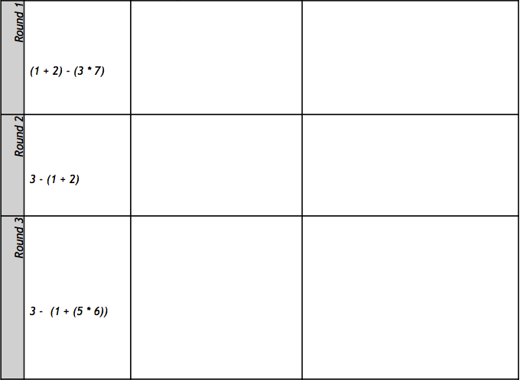
Circles Triathlon
-
(- )
(* 3 7)
(+ 1 2)
*
+
(3 * 7) – (1 + 2)
*
+
3
7
1
2
3
7
1
2
-
(- 3 (+ 1 2) )
3
+
1
2
-
+
(- 3 (+ 1 (* 5 6) ) )
3
1
*
5
6

Slide 29
Contracts
<name> : <domain> → <range>
; MrCoffee : Beans Water → Coffee
; + : Number Number → Number
; - : Number Number → Number
; sqrt : Number → Number
; sqr : Number → Number
Can you fill out the contracts for +, -, *, and / ?

Slide 30
Strings and Images
One of these things is not like the other…
12 -53 “hello” 4.9
A String is anything with quotes around it: “hello!”, “Houston” and “42” are all strings.
How would you convert this to code?
star
(star 50 “solid” “red”)
50 “solid” “red”

Slide 31
More Image Functions
; circle : Number String String → Image
; ellipse: Number Number String String → Image
; triangle: Number String String → Image
; rectangle: Number Number String String → Image
; text: String Number String → Image
; rotate : Number Image → Image
; scale: Number Image → Image
…and dozens more!

Slide 32
Error Messages
How we react is key: are we scared or excited?
“The computer is giving you a clue…”
“What do you think it’s trying to tell us…?”

Slide 33
10min Break!

Slide 34
Unit 3

Slide 35
Defining Values
Open the “Defining Values” link from the teachers-only page, and Run
What do you think the code on line 3 does? Line 4?
What will happen if I evaluate TITLE in the Interactions window?
How could we change the title of our game?
Click “Save”, and name your file
What other definitions do you see?
Playing with SCREENSHOT…
Make your images!!!

Slide 36
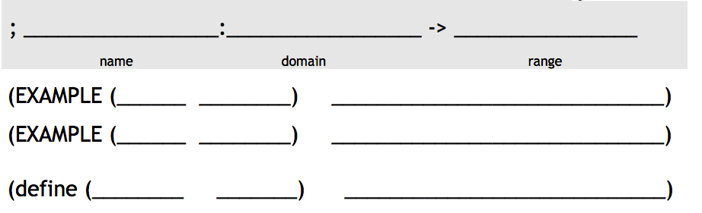
Defining Functions
I just loooove green triangles….
Write a function ‘gt’, which takes in a number and gives back a solid, green triangle of the given size.
gt
Number
Image
radius
size
size
size
gt
10
(triangle 10 “solid” “green”)
gt
gt
11
(triangle “solid” “green”)
(triangle 11 “solid” “green”)

Slide 37
Defining Functions
Confession: I lied. I actually prefer blue circles!
Write a function ‘bc’, which takes in a number and gives back a solid, blue circle of the given radius.
bc
Number
Image
radius
radius
radius
radius
bc
16
(circle 16 “solid” “blue”)
bc
99
bc
(circle “solid” “blue”)
(circle 99 “solid” “blue”)

Slide 38
Unit 4

Slide 39
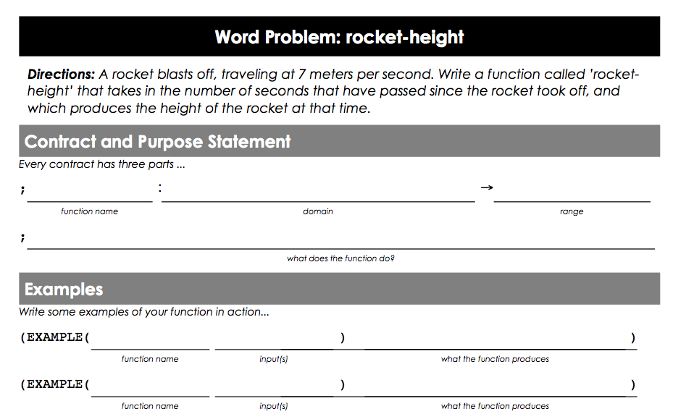
rocket-height
rocket-height
Number
Number
rocket-height
Given the number of seconds, how high is a rocket, traveling at 7m/s?
seconds
radius
15
105
(* 7 15)
rocket-height 289
(* 7 289)

Slide 40
Connect to math
Why do we have students say things in their own words?
When do we have students write examples before defining functions? Do you do this in your classroom?

Slide 41
Challenges
Can you make the rocket fly faster? Slower?
Can you make it fly backwards?
Can you make it fly faster over time?

Slide 42
Practice
red-square
yard-area
New technique: Battling
Confidence-building tool
Helps students be independent
Scaffolds presenting and communicating

Slide 43
Unit 5

Slide 44
Animating your Characters
Open the ”Game Template” link from the teachers-only page
Add your game images!
Complete update-target and update-danger

Slide 45
For Practice…
Sally sells lemonade for $1.75/glass. Describe her revenue as a function of the number of glasses sold.
It costs Sally $0.30 to buy the sugar and lemons for each glass of lemonade she sells. Describe her cost as a function of the number of glasses sold.
Profit = revenue - cost. Describe Sally’s profit as a function of the number of glasses sold.

Slide 46
Unit 6

Slide 47
True and False…
A game of True or False…
Evaluate the following 3 pieces of code:
(+ 1 4) (* 7 5) (< 3 4)
Try using other Boolean functions
There’s also string=?
Introducing Sam the Butterfly…
Complete page 19

Slide 48
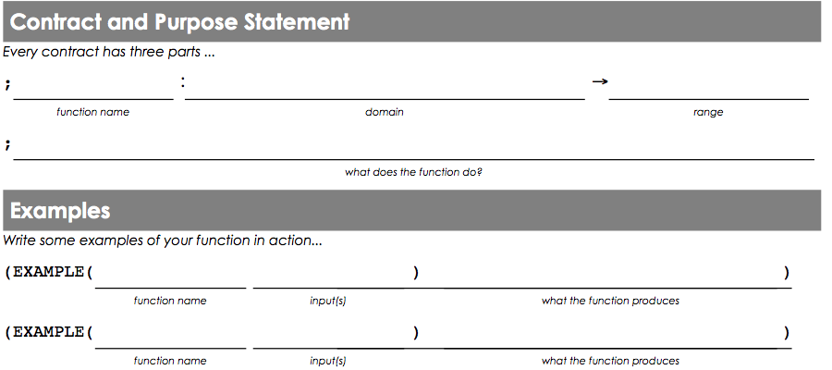
safe-left?
Let’s have a volunteer…
safe-left?
Number
Boolean
Given an x-coordinate, check if it is greater than -50
x
x
x
x
safe-left?
-100
(> -100 -50)
safe-left?
320
(> 320 -50)

Slide 49
Finishing onscreen?
Complete safe-right? and change onscreen? so it uses safe-right? instead
How can onscreen? use both functions?
Challenge: change the boundaries so that no part of Sam can leave the screen.
Copy the safe-left?, safe-right? and onscreen code into the game template!

Slide 50
10min Break!

Slide 51
Unit 7

Slide 52
Luigi’s Pizza
What does (cost “cheese”) evaluate to?
What will happen for (cost “onion”)?
Add “mushroom” to the menu, for $11.99.
Change the code to add your favorite topping!
Challenge: Write a detailed description of how you think cond works.

Slide 53
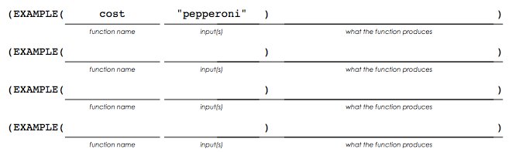
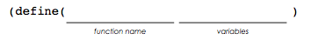

Extending the Design Recipe
cost
String
Number
topping
cost “pepperoni”
10.50
price
cost “cheese”
9.00
cost “chicken”
11.25
cost “broccoli”
10.25
cost
topping
cond
 | 10.50
 | 9.00
 | 11.25
 | 10.25
(string=? topping “pepperoni”)
(string=? topping “cheese”)
(string=? topping “chicken”)
(string=? topping “broccoli”)

Slide 54
update-player
update-player
Number String
Number
update-player 320 “up”
(+ 320 20)
key
update-player 100 “up”
(+ 100 20)
function
update-player 320 “down”
(- 320 20)
y
y
update-player 100 “down”
(- 100 20)
update-player
y key
cond
(string=? key “up”)
(string=? key “down”)
else
(+ y 20)
(- y 20)
y

Slide 55
Challenges
GoFast: Make a set of “secret keys” that move the player faster than the up and down arrow.
Warping: “b” jumps to the bottom, “t” to the top, etc.
Wrapping: moving the player to the top of screen makes it re-appear at the bottom.
Blocking: prevent the player from leaving the screen
Hiding: Press a key to hide. Press the same key to re-appear at the same place.

Slide 56
The last lessons…

Slide 57
At the End..
Share your programs!
Practice submitting as a HW Assignment
Use the “tilt” teachpack to support phones/tablets
Add data structures to support 2d motion and graphing
Building on what you know…all the way to college

Slide 58
Implementation

Slide 59
Integration
Transferable Skills
Circles of Evaluation
Design Recipe
Rocket-Height
Target/Danger Motion
Sam the Butterfly
Luigi’s Pizza
Player Motion
Collision Detection
Notes:
What’s different for pre-algebra and earlier?

Slide 60
Integration
Transferable Skills
Circles of Evaluation
Design Recipe
Rocket-Height
Target/Danger Motion
Sam the Butterfly
Luigi’s Pizza
Player Motion
Collision Detection
Notes:
100 Days devoted to material that Bootstrap Covers

Slide 61
Next Steps
You’ll need access to a computer lab
You’ll need Google accounts
Join our Google Group for questions and answers
Figure out your integration plan

Slide 62
Sample Questions for Breakout
What elements are usable without a computer?
What elements would you like to integrate?
What will be the challenges for using Bootstrap?
Create a rough calendar for when you might use each section of Bootstrap.
Report back after the breakout!

Slide 63
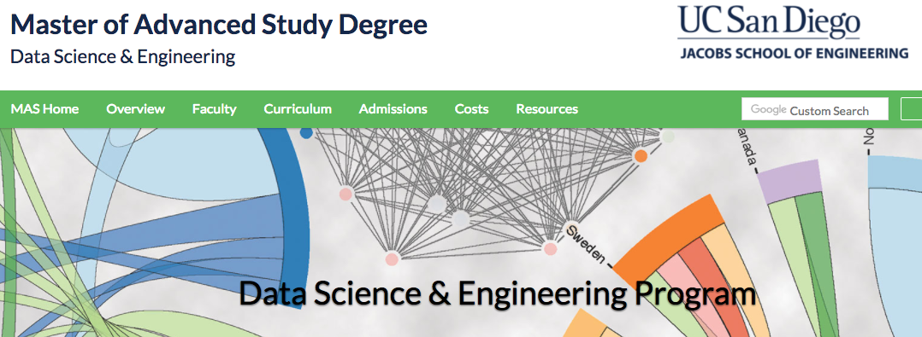
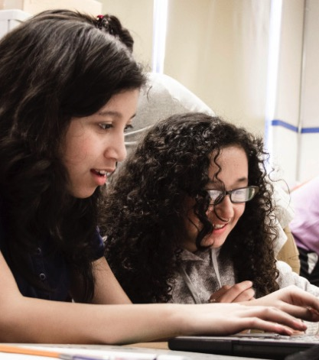
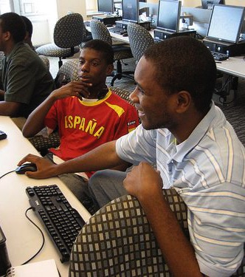


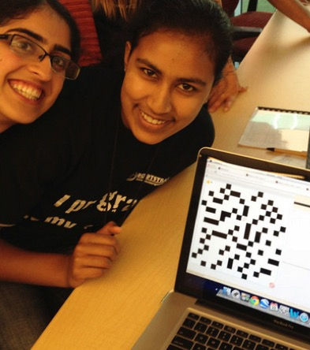
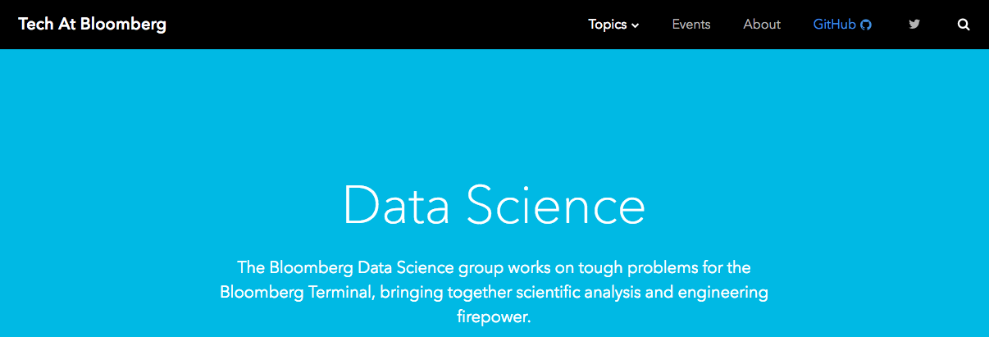
Algebra
Bootstrap:Algebra applies algebraic
concepts and rigorous programming
principles to creating a simple
videogame. Students use order of
operations, function composition, the
distance formula, coordinates and inequalities in the plane to detect collisions, handle keystrokes, and determine how they move and interact – with each challenge framed as a standard word-problem. The module is aligned to National & State Standards for Mathematics, the CSTA standards and K12CS frameworks, and has been shown to improve students’ performance on standards algebraic tasks*.
DataScience
Which artist do you listen to most? Do
schools in richer areas of your town do
better than those in poorer ones? What’s
the healthiest cuisine? Our Data Science
module teaches students to view
programs as questions we ask of data. Students form their own questions about the world around them, and learn to analyze data critically and carefully to find answers. Business, science, and history teachers can utilize this module to help students make inferences from data. Math teachers can use this module to introduce statistics in an accessible way. It also works great as a module for AP CS Principles’ unit on data!
Physics
This module is developed in partnership
with the American Association of Physics
Teachers & American Modeling Teachers
Association. It helps students understand
dynamics concepts by using
programming to build models of the
physical world. The module is targeted at ninth grade, a year in which every student is expected to take science. The module is aligned to the Physics First movement, allowing teachers to present computational modeling as a basic tool to students preparing to study science more broadly.
Reactive
Bootstrap:Reactive goes deeper into
programming, building events and data
structures on top of the foundation laid by
our intro courses and allowing students to
build far more sophisticated programs.
Students learn how the event loop that drives their Bootstrap:Algebra game works, and use it to create animations using simple datatypes. They then learn about data structures, and design a structure for a sophisticated game of their own design. Bootstrap:Reactive is aligned to the CSTA standards and K12CS frameworks.
Notes:
This is just one part of a multi-facet pathway that we at Bootstrap have created. Bootstrap:Physics allows your physics teacher to integrate computing into a standard HS Physics class, and Bootstrap:Reactive allows your students to go deeper into CS by building on – rather than throwing away – what they’ve learned. But there’s also a new trend in CS, which is taking over universities and the corporate world: Data Science. Here are just a few screenshots of major institutions that are pushing for Data Science. And now…Bootstrap is offering an introductory Data Science module for middle or high school, which requires no computing background!

Slide 64


Connect with Us!
/ BootstrapWorld
@BootstrapWorld
Questions:
bit.ly/BootstrapHelp
Grab a photo!

Slide 65
We’d like your feedback!

